Slide 1




Slide 2


Networking (API Calls)

Slide 3


About me
Ameur Nassim
2nd year student at ESI
Dev member at GDG Algiers
Contact: kn_ameur@esi.dz

Slide 4

Plan
What’s an API
Flutter and APIs
WorldTime API example

Slide 5
What’s an API
Technically stands for Application Programming Interface
An API is a set of programming code that enables data transmission between one software product and another. It also contains the terms of this data exchange.
An API allows your application to interact with an external service using a simple set of commands.

Slide 6
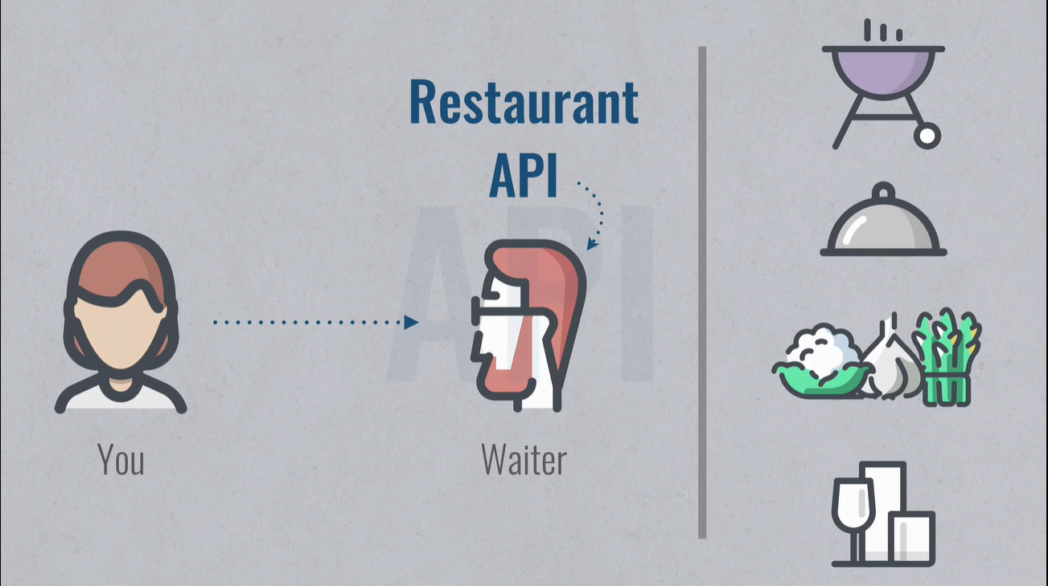
What’s an API

Slide 7
What’s an API
Types of APIs:
Private APIs: These application software interfaces are designed for improving solutions and services within an organization. Even if apps are publicly available, the interface itself remains available only for those working directly with the API publisher.
Partner APIs: Partner APIs are openly promoted but shared with business partners who have signed an agreement with the publisher
Public APIs : Also known as developer-facing or external, these APIs are available for any third-party developers.

Slide 8
What’s an API
Other types of APIs:
Database APIs,
Operating System APIs,
Remote APIs
and Web APIs…

Slide 9
Flutter & APIs
We can use APIs with Flutter very easily and that using some packages like:
HTTP package
Or Dio package
For this workshop we will use the HTTP Package

Slide 10
Flutter & APIs
HTTP package:
This package contains a set of high-level functions and classes that make it easy to consume HTTP resources. It's multi-platform, and supports mobile, desktop, and the browser.
It has requests methods: Post, Get ….

Slide 11
WorldTime API Example
Let’s Practice

Slide 12
Thanks

Slide 13


